Slide 1

TOPIC
NATIONAL AWARDS
Submitted to:- sHAshwat Singhal
submitted by :- unnati Chaurasia

Slide 2
INTRODUCTION
National Awards are prestigious honors given by the Government of India to recognize and appreciate individuals and organizations for their outstanding achievements and contributions to society. These awards are presented in various fields such as arts, literature, science, sports, education, public service, and cinema. National Awards encourage excellence, inspire citizens to perform better, and acknowledge the efforts of those who have made a significant impact on the nation.

Slide 3
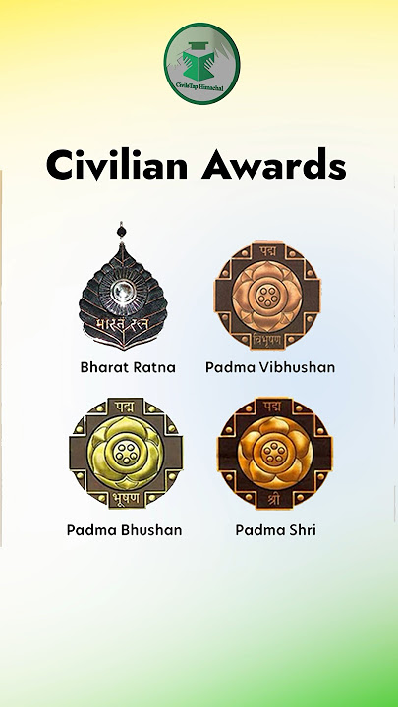
CIVILIAN AWARD
Bharat Ratna – Highest civilian award in India.
Padma Vibhushan – Second-highest civilian award.
Padma Bhushan – Third-highest civilian award.
Padma Shri – Fourth-highest civilian award.

Slide 4

NATIONAL SPORTS AWARDS
Major Dhyan Chand Khel Ratna Award
Arjuna Award
Dronacharya Award
Dhyan Chand Award
Rashtriya Khel Protsahan Puraskar
Maulana Abul Kalam Azad (MAKA) Trophy

Slide 5

SCIENCE AWARDS
Shanti Swarup Bhatnagar Prize
Vigyan Ratna Award
Rashtriya Vigyan Puraskar
Young Scientist Award
INSA Medal for Young Scientists

Slide 6
DIFFERENCE BETWEEN
PADMA VIBHUSHAN AND PADMA BHUSHAN
Basis | Padma Vibhushan | Padma Bhushan
Rank | Second-highest civilian award in India | Third-highest civilian award in India
Purpose | Awarded for exceptional and distinguished service | Awarded for distinguished service of a high order
Prestige | Higher prestige and recognition | Lower than Padma Vibhushan but highly prestigious
Established | 1954 | 1954
Fields | Arts, Science, Public Affairs, Medicine, Literature, Sports, etc. | Arts, Science, Public Affairs, Medicine, Literature, Sports, etc.
Order of Awards | Bharat Ratna → Padma Vibhushan → Padma Bhushan → Padma Shri | Comes after Padma Vibhushan and before Padma Shri

Slide 7

NATIONAL AWARDS IN LITERATURE
Jnanpith Award
Sahitya Akademie Award
Saraswati Samman
Recognize excellence in Indian literature and writing.

Slide 8


Slide 9
ELIGIBILITY FOR NATIONAL AWARDS
Open to all Indian citizens.
In some cases, foreign nationals can also receive awards.
Awards are based on merit and outstanding contribution.
No discrimination based on race, religion, gender, or profession.

Slide 10
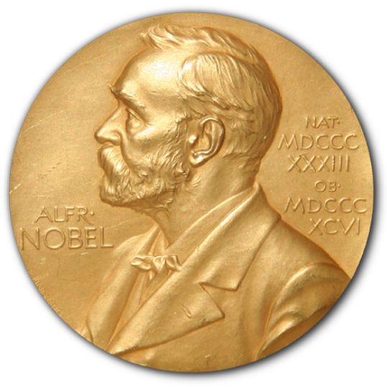
CONCLUSION
National Awards honor exceptional achievements.
They recognize contributions to the nation's growth.
Awards inspire excellence, dedication, and innovation.
They reflect India's appreciation for talent and service.

